Slide 1

Unilever Supply Chain (Personal Research)
By Eka Nur Solicha
Disclaimer: The data collected from various sources, analysis conducted personally by author.

Slide 2
Supply chain model
The supply chain model adopted by Unilever is the Continuous-Flow Model since Unilever have a stable demand due to its industry nature, FMCG, which always has a constant order with little variations to its products.
KALIMANTAN
Raw material supplier
MED
PKB
SMD
MDO
IRIAN JAYA
Retailers
Consumer
PAD
PON
CDC -> DEPO
PLB
SUMATERA
BMS
Raw material supplier
Factories
MKS
SULAWESI
JKT
SBY
Online shop/
e-commerce
Consumer
JAVA
DPS
Central Distribution Center (CDC) or Back of Factory (BOF)s
Depo/DC
*Source: Unilever Supply Chain Division, 2013
Raw material supplier

Slide 3
More about Continuous-Flow Model
Continuous-Flow models relies heavily on high demand stability. Meaning that the demand for the products of the company is high and has a little variation. For example Unilever has their own product line in food and drink, home care, and personal care. The buyer has high demand of Unilever’s product and cannot request a certain customization for the product that the Unilever’s produce (little variation in consumer demand profile)
What unique about continuous flow model?
1. Relies on high demand stability
2. Offer continuous replenishment (Unilever distributor will go to traditional market and will deliver the goods in a certain time frame. In case of big retailer, they have a schedule on when to go to each branch of the retailers)
3. Generate regular cadence of product and information flow
Attributes in Continuous-flow Model:
1. Connectivity (information flow crucial to implement the continuous replenishment)
2. Collaboration (inter-organizational collaboration to ensure the production of goods to get high demand stability; Unilever establish partnership with many retailers with multiple branches across Indonesia)
3. Distribution (Bringing product to the customer as close as possible; Unilever have central distribution center and depo in several location throughout Indonesia to enable optimum distribution. Unilever also have a distribution map for the cities in Indonesia– presented in the previous slide )

Slide 4
Key Driver & Key Strategies
Raw Material Supplier | Factory | Storage/Depo | Retailers | Online Shop
Key Driver Information Sourcing Key Strategies Procurement Material quality control Raw material supplier need to ensure the availability of raw materials needed by the factory. By placing a large quantity of order in a certain time and establishing a contract with the factory, the supply chain can be more effective. | Key Driver Information Production Sourcing Key Strategies Supplier selection Procurement (i.e. volume consolidation) Information on how many, what to produce, when, etc. Factory need a sufficient information to produce the goods based on the market demand and ensure the availability of raw material by placing purchase order. | Key Driver Information Inventory Transportation Key Strategies Stock-tracking (capacity, flexibility, etc.) Open smaller storage branches Delivery routing Storage need to maintain the inventory availability as well as the responsiveness to buyer’s order by establishing the delivery routing. They could also decide whether or not to have their own delivery vehicle. | Key Driver Information Inventory Pricing Key Strategies Discounts Stock-tracking (how much item stock, where to store, etc.) Open branches of stores in various areas As a retailer, they need their own stock-tracking to find the balance between demand and inventory. Pricing strategy and strategic location also needed to attract buyers. | Key Driver Information Transportation Pricing Key Strategies Promos Partnership with delivery services Technology enhancement Online store relies heavily on the information of buying transactions. They need to provide easiness to the consumer in purchasing order as well as giving promos to attract buyers

Slide 5
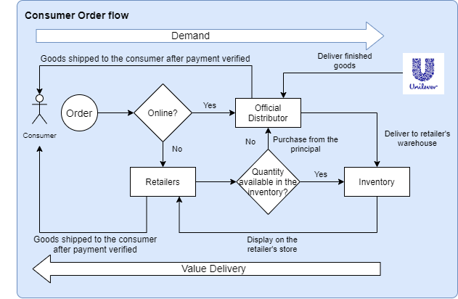
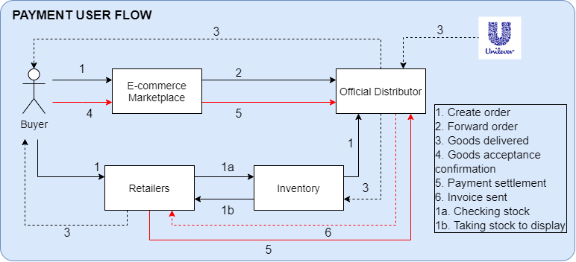
Flow Order & Payment from Customer

Slide 6
Accounting
Scenario 1:
1. Buyer creates order to Unilever through online marketplace
2. Online store forward the order to Unilever official distributor
3. Unilever official distributor ships it to the buyer, FOB Shipping point
4. Buyer accept the goods and confirm they have accepted through the application
Debit | Credit
Account Receivable | Sales Revenue
Debit | Credit
Cost of good sold | Merchandise Inventory
Debit | Credit
Cash | Account Receivable

Slide 7
Accounting
Scenario 2:
1. Unilever buy raw material from supplier
2. Unilever produce a finished goods from the raw materials
3. Retailer order from Unilever and Unilever issue an invoice
4. Unilever ships the goods to retailer with FOB destination method
Debit | Credit
Raw materials | Cash
Debit | Credit
Merchandise inventory | Raw materials Production Cost (Raw Material, Direct Labor, Factory Overhead)
Debit | Credit
Account Receivable | Sales Revenue
Debit | Credit
Delivery Expense | Cash

